Slide 1
A Project in Natural Language Processing on the enron emails dataset
Pratik Misha 14493
Manuj Narang 14373

Slide 2
WHY ENRON ?
Having started selling energy as financial instruments, Enron an energy, commodities, and services company bagged “America’s most innovative company” for 6 consecutive years.
-Started in 1985, Enron went on to become one of the Fortune 10 Companies and had an on-paper revenue of abouve $60 billion.
-Took them to 24 days(Oct. 16 to Nov8, 2001) from announcing a $100 billion revenue to bankruptcy, which definitely indicated fraudulent activities occurring in the company.

Slide 3
Project Objective
Developing a company heirarchy structure using communication between employees and finding indicators for fraudelent behavior in emails

Slide 4
TASKWISE DIVISION OF PROJECT
Information extraction and preliminary analysis
Building a hierarchy structure for the organization
Topic Modelling
Inferences

Slide 5
DATA EXTRACTION
Column 1: file location, Column 2: email in the standard format.
Features extracted : Message-ID(unique for every message), Date(stored in date time format), From, To, Subject, Mime-Version, Content-Type, Content-Transfer-Encoding, X-From, X-To, X-cc, X-bcc, X-Folder, X-Origin, X-FileName, content, user(extracted from column 1, ie. email file location)
All the emails with multiple receiving email addresses(1<n<480) were considered separately.
The conversations in which a user X replies to a person Y or the email thread is continued on for some number of time, were considered separately.
All the user names(150), linked to their corresponding emails were stored as a dictionary.
All the instances where the essential information like(email: to wasn’t there(around 586)) were removed from the main DataFrame.

Slide 6
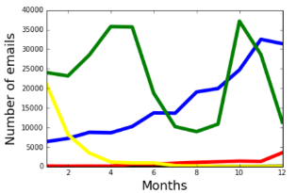
PRELIMINARY ANALYSIS
Increasing for the year 1999, 2000 and 2001(till mid May), the email conversations suddenly appeared to be decreasing, hitting a low at August 1(which also conincided with the resignation date of the ceo Jeffrey Skilling).

Slide 7
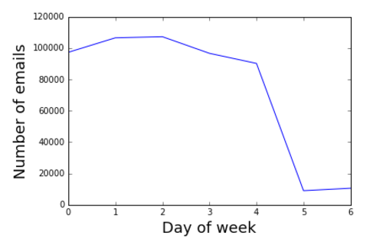
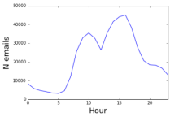
PRELIMINARY ANALYSIS
Justifies the fact that the company was listed in the stock exchange.(closed for saturdays and sundays.)
The dip in the number of emails, justifying the lunch hours.

Slide 8
SOCIAL NETWORK ANALYSIS
We Considered a Hierarchy Structure:
Director>Administrative_Assistant>DIrector>Manager>Staff~Analyst~Specialist
(As mentioned in https://www.ii.pwr.edu.pl/~brodka/art/2011_IJKSR.pdf , this is used to check the hierarchy obtained from the social score, which is calculated.)
As the operations involved(mentioned in the next slide), were computation heavy, hence all the email addresses(which are represented as vertex in the graph) with
no. of emails(sent+received)< 50, were dropped from the Data Frame.

Slide 9
SOCIAL NETWORK ANALYSIS
We constructed an undirected graph where vertices represent various accounts and edges, communication between the edges.(used networkx for graph construction and other operations).
Nodes in the graph = 26310
Edges in the Graph= 57677
A social score is computed for each vertex considering:
  1. Email Count - Number of Emails sent and received. Converted “From” and “To” columns to lists and then using <collections.Counter> gives the count. Normalized by dividing by total emails communications in the connected componenet.
  2. Average Response time- time between the email sent by the user and receiving an email from the same user.(considered only if et<3 days). Grouped pandas DataFrame by columns “To” and “From” and then sorted the group by time to make the task easier.
  3. Response Score : combination of of number of responses and average response time.

Slide 10
SOCIAL NETWORK ANALYSIS
  .
  4. Number of cliques: number of maximal complete subgraphs that the account is contained within. Normalized by total number of maximal cliques in the connected component
  .
  5. Clique Score: computed using a size of the given account’s clique set. Bigger cliques are worth more than smaller ones, importance increases exponentially with size.
  6. Centrality Degree: count of number of ties to other actors in the network.
  7. Clustering co-efficient:likelihood that two associates of a node are associated themselves.
  8. Mean of shortest path from a specific vertex to all the vertices in the graph.
  9. Betweenness centrality: number of people the vertex is connected to indirectly through their direct links.
All the values considered to contribute equally and scaled to [0,100] and then the social score is computed.
Networkx functions used : number_of_cliques(), degree_centrality(), betweenness_centrality(), average_clustering(), all_shortest paths().

Slide 11
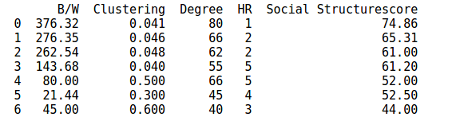
SOME SPECIAL SCORES AND HEIRARCHY POSITIONS
The social structure scores are calculated using the method described in the previous slide and HR represents the level to which they belong
Indexes are matched with the user name, using the dictionary stored previously.
68% of the vertices were in the correct hierarchial order, and 26% had a mismatch of 1 level and rest had a mismatch of 2 levels.

Slide 12
DIFFICULTIES FACED
The DataFrame(created during the information extraction), was large and hence all the computations related to it ( grouping data etc ) was time consuming.
All the networkx functions had high computational costs because the graph had large number of nodes and vertices.
Many users sent many mails from their id to themselves, hence causing errors. They mails sent to oneself weren’t considered.
Only for one connected component containing Administrator, the social score could be calculated as as the process was time consuming and required greater computational capabilities

Slide 13
ROOM FOR IMPROVEMENT
For the hierarchy structure, only meta data related to the emails were considered while the content of the emails were not used.
Content of the emails could provide valuable information about the hierarchy of the company.

Slide 14
FURTHER ANALYSIS OF ENRON DATASET
We implemented topic modelling on the enron emails dataset by using Latent Dirichlet Allocation(LDA)

Slide 15
WHY TOPIC MODELLING
We tried to find a pattern in the occurence of particular topics in the emails with their variation with time

Slide 16
LATENT DIRICHLET ALLOCATION
In natural language processing, latent Dirichlet allocation (LDA) is a generative statistical model that allows sets of observations to be explained by unobserved groups that explain why some parts of the data are similar.
LDA is an example of a topic model and was first presented as a graphical model for topic discovery by David Blei, Andrew Ng, and Michael I. Jordan in 2003.
We implemented LDA on the enron dataset using Gensim.

Slide 17
PREPROCESSING THE DATA
We cleaned the data by removing the metadata from the emails like the email addresses and dates that would have added noise to the dataset.
We retained only the content of the emails after tokenization, stop word removal and stemming.
We converted the tokens into BOW representaion and applied the LDA model to get the results.

Slide 18
INITIAL RESULTS OF LDA
We tried to split the words in the enron email dataset into 4 different topics and extracted out the 20 most common words in each topic
However, two of those topics did not yield a coherent pattern for us to interpret its meaning. So we interpreted that as noise.
But two topics showed good coherence for us to find a pattern in their words.

Slide 19
“MEETING” LIST
thanks
call
don
week
meeting
mail
day
enron
message
hope
houston
home
vince
love
night
friday
thursday
tomorrow
talk
weekend

Slide 20
“BUSINESS” LIST
enron
power
energy
market
company
business
california
gas
risk
vince
jeff
trading
management
information
price
meeting
markets
financial
news
prices

Slide 21
DISTRIBUTION OF TOPICS WITH TIME
The enron email dataset spans from 1998 to 2002.
We have plotted the distribution of the occurence of words from
the two lists against this period of time divided into 60 months.
This Visualization enabled us to find a pattern in their distribution.
The fraudulent behavior surface around mid 2001 ,i.e, after 38-40 months.

Slide 22
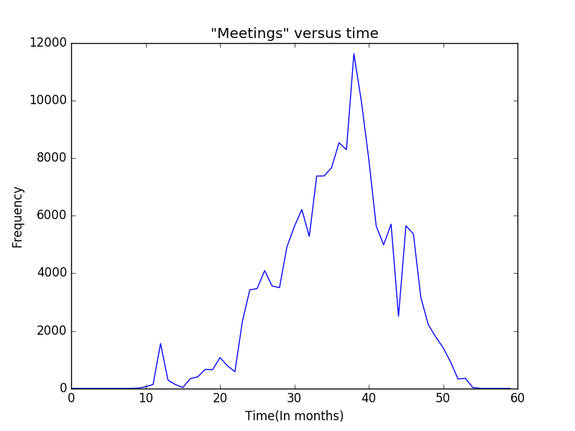
PLOT OF MEETINGS LIST VERUS TIME

Slide 23
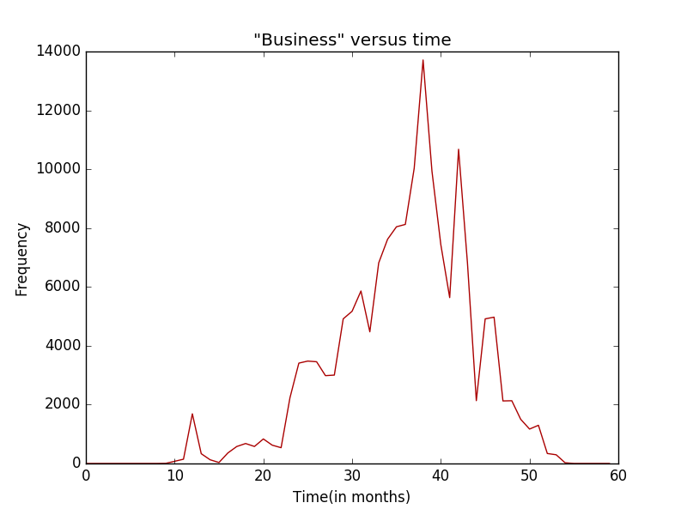
PLOT OF BUSINESS LIST VERSUS TIME

Slide 24
COMPARISON
The frequency of meetings clearly seemed to drop during the time of suspected fraudulent activity.
At the same time, words such as 'risk' or 'financial' or 'energy' peaked in frequency.

Slide 25
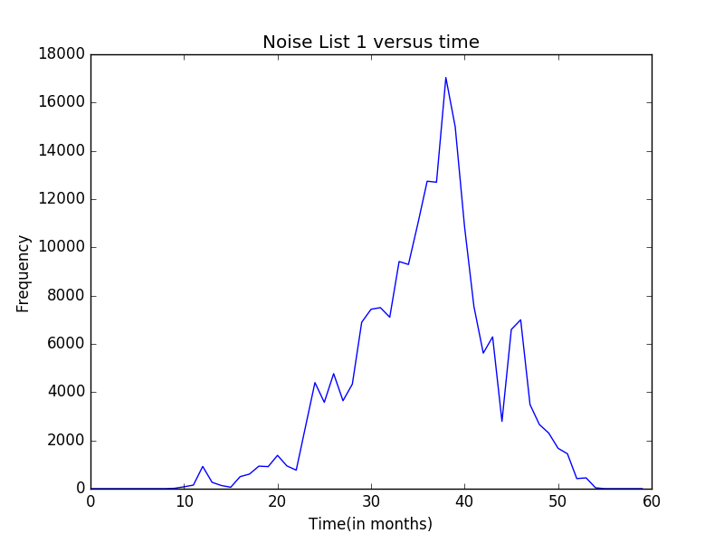
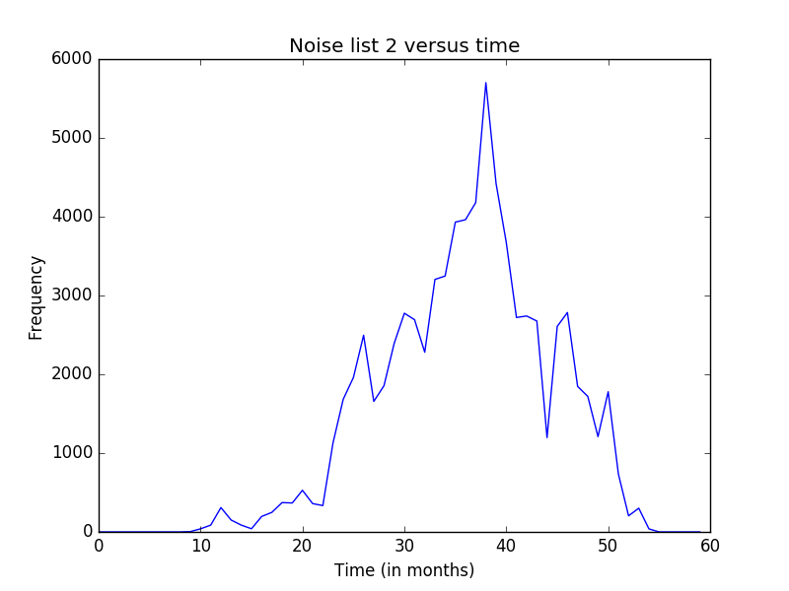
CONFIRMATION THAT THE TREND IS NOT COINCIDENCE

Slide 26
INFERENCES FROM INDIVIDUALS
We looked for the distribution of the frequency of the two lists in each individuals' emails and plotted them against time.
We tried to find clusters in those plots to identify the people who had similar plots which could indicate fraudulent behavior.
We used plots of people we knew to be guilty as references for clustering.

Slide 27
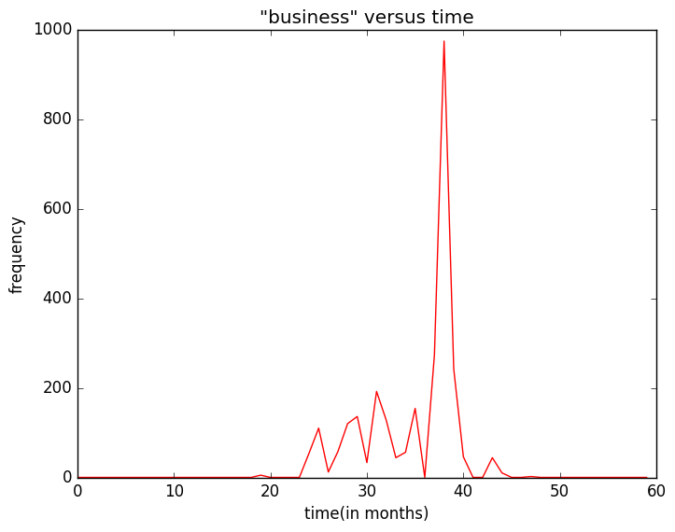
Business plot for Kenneth Lay
Kenneth Lay was the CEO and Chairman of the enron Corporation. He was found guilty of 10 accounts of securites fraud.
There is a sharp peak right before the 40 month mark when the scandal was very
active and extremely dormant after the 40 month mark during the Audit period.

Slide 28
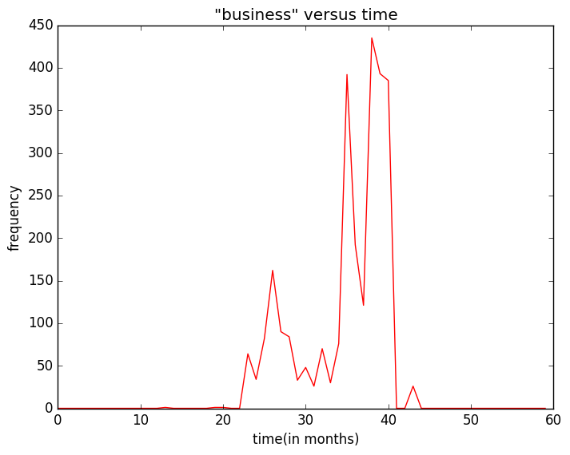
BUSINESS PLOT FOR JEFFREY SKILLING
Jeff Skilling was the former CEO of enron Corporation and was found guilty in 2006 of felony charges related to enron's financial collapse.
In his case too,the peak happens in the 35-40 month period and goes extremely dormant in the audit period.

Slide 29
OBSTACLE FACED IN CLUSTERING
Very few emails are available of the known “main players” in the enron email dataset
Thus the basis for clustering is not very strong.
Most emails are from people who were not in the limelight during the scandal

Slide 30
CLUSTERING SCHEME
We looked for people who had the plots similar to those of Kenneth Lay and Jeff Skilling

Slide 31
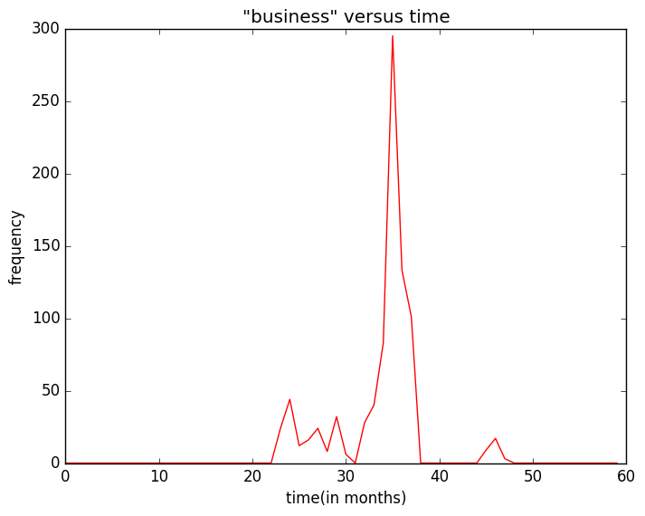
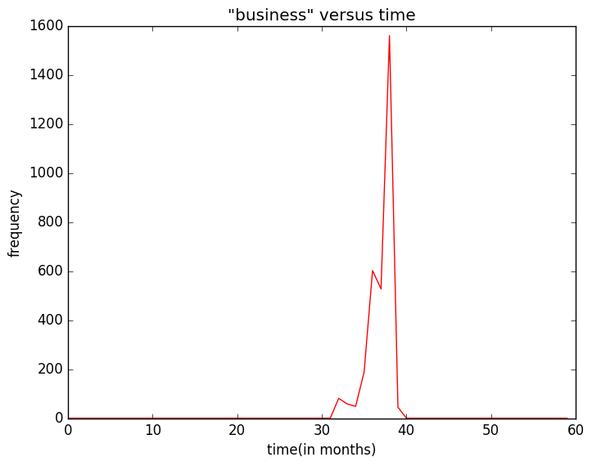
PLOTS SIMILAR TO THOSE OF KENNETH LAY AND JEFF SKILLING

Slide 32
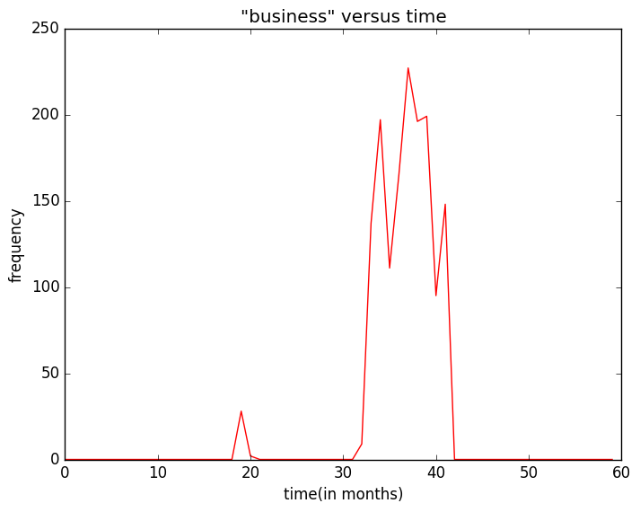
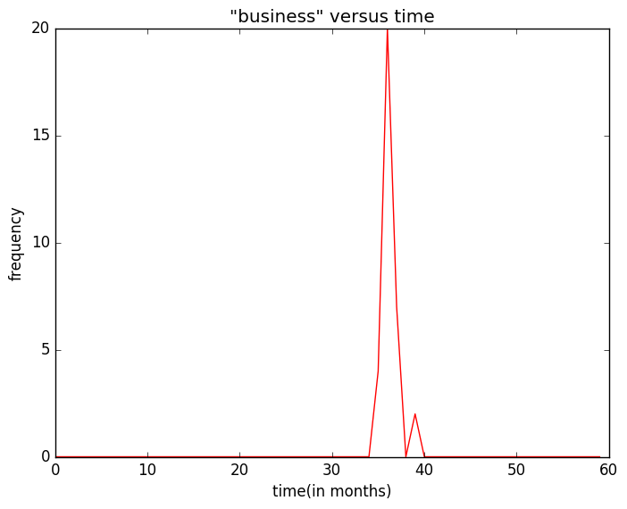
PLOTS SIMILAR TO THOSE OF KENNETH LAY AND JEFF SKILLING

Slide 33
TROUBLE WITH CROSS VALIDATION
There is little to no information available on the internet about the involvement of most of the people in the email dataset that we clustered.
Emails for the key players of the scandal are missing in the dataset.

Slide 34
Conclusion from Topic Modelling
We have seen that topic modelling could be used to identify periods of fraud on a timescale using plots of frequency versus time.
This could be used to identify fraud in other companies.
This technique could be used to single out individuals using clustering.

